Slide 1
Endterm Overview
2024-12-26

Slide 2
Ch9 Relations Summary
Relations and Their Properties
Reflexive Relations ∀x[x ∈ A ⟶ (x,x) ∈ R]
Symmetric and Antisymmetric Relations
∀x∀y [(x,y) ∈ R ⟶ (y,x) ∈ R]
∀x∀y [(x,y) ∈ R ∧ (y,x) ∈ R ⟶ x = y]
Transitive Relations ∀x∀y ∀z[(x,y) ∈ R ∧ (y,z) ∈ R ⟶ (x,z) ∈ R ]
Question: How many relations are there on a set A? How many reflexive relations are there on a set with n elements?
Theorem 1: The relation R on a set A is transitive iff R^{n} ⊆ R for n = 1,2,3 ….
Representing Relations MSºR = M_{R} ʘM_{S}
Closures of Relations
Equivalence Relations
Partial Orderings

Slide 3
Definition
Let A and B be nonempty sets. A relation R from A to B is a subset of A × B.
If R ⊆ A × B and (a, b) ∈ R, we say that a is related to b by R, and we also write a R b.
Define R(x), the R-relative set of x, to be the set of all y in B with the property that x is R-related to y.
R(x) = {y ∈ B | x R y}.

Slide 4
The Matrix of a Relation
Let A = {a₁, a₂, . . . , a_{m}} and B = {b₁, b₂, . . . , b_{n}}, R is a relation from A to B.
The m × n matrix M_{R} = [ m_{ij} ] defined by
the join of two matrices M₁, M₂, denoted M₁ ∨ M₂ , is the connection matrix for R₁ ∪ R₂.
the meet of two matrices M₁, M₂, denoted M₁ ∧ M₂ ,is the connection matrix for R₁ ∩ R₂ .

Slide 5
Closure
The closure(闭包) of a relation R with respect to property P is the relation obtained by adding the minimum number of ordered pairs to R to obtain property P.
Theorem:
Let R be a relation on A.
The reflexive closure of R, denoted r(R), is R∪Δ.
The symmetric closure of R, denoted s(R), is the relation R∪R⁻¹. R⁻¹={(b,a) | (a,b)∈R}
the transitive closure of R, denoted t(R),

Slide 6
Warshall’s Algorithm
a_{k}
a_{i}
a_{j}

Slide 7
equivalence relation
A relation R on a set A is an equivalence relation (等价关系) iff R is reflexive, symmetric, transitive.
a R b iff R(a) = R(b)
Let R be an equivalence relation on a set A. The set of all elements that are related to an element a of A is called the equivalence class of a. denoted by [a]_{R}. [a]_{R} = {s|(a,s) ∈ R.
[a] = [b] or [a] ∩ [b] = ∅
Let R be an equivalence relation on a set S. Then the equivalence classes of R form a partition of S.
The partition P consists of all equivalence classes of R is denoted by A/R and called the quotient set (商集).
Let R be a relation on set A, then tsr(R) is an equivalence relation on A.

Slide 8
Partial order（偏序关系）
Partial order: A relation R on a set A is called a partial order if R is reflexive, antisymmetric, and transitive.
Partially ordered set: or simply a poset, denoted by (A, R).
If (A, ≤) is a poset, the elements a and b are said to be
Comparable（可比的） if a ≤ b or b ≤ a.
incomparable (不可比的）if neither a ≤ b nor b ≤ a.
If every pair of elements in a poset A is comparable, we say that A is a linearly ordered set.
Notes:
等价关系其实是其上各个等价类集合的全关系 组合. 少见, 主要应用是集合A的划分.
非等价关系的应用更广泛,其中一类是偏序关系.

Slide 9
Partial order Summary
product partial order
If (A,≼₁) and (B,≼₂) are posets, then (A×B,≼) is a poset, with partial order ≼ defined by
(a,b) ≼ (a',b') if a≼₁a' in A and b≼₂b' in B.
Lexicographic Orderings
Given two posets (A₁,≼₁) and (A₂,≼₂), the lexicographic ordering on A₁ ⨉ A₂ is defined by specifying that (a₁, a₂) is less than (b₁,b₂), that is, (a₁, a₂) ≺ (b₁,b₂),
either if a₁ ≺₁ b₁ or if a₁ = b₁ and a₂ ≺₂ b₂.
Hasse Diagrams
Topological Sorting
Lattices

Slide 10
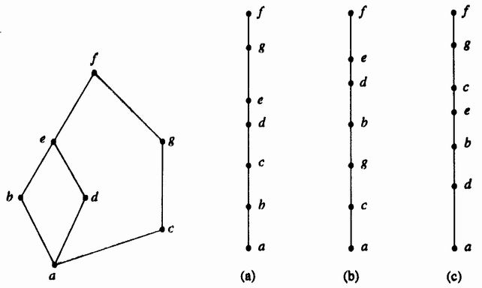
Topological Sorting Algorithm
Repeat steps : Choose a minimal element a of A.

Slide 11
Extremal elements
maximal element（极大元）: no element c in A such that a ≼ c.
minimal element（极小元）: no element c in A such that c≼ a.
greatest element（最大元）: if x ≼ a for all x ∈ A.
least element（最小元）: if a ≼ x for all x ∈ A.
upper bound（上界） of B: if b ≼ a for all b ∈ B.
lower bound（下界）of B: if a ≼ b for all b ∈ B.
least upper bound (LUB) of B: if a ≼ a’ for all a’ upper bound of B.
greatest lower bound (GLB) of B: if a’ ≼ a for all a’ lower bound of B.

Slide 12
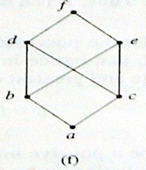
Lattice
A lattice is a poset in which every subset {a,b} consisting of two elements has a least upper bound and a greatest lower bound.
denote LUB({a,b}) by a∨b and call it the join（并） of a and b.
denote GLB({a,b}) by a∧b and call it the meet（交） of a and b.
Example: S={a,b,c}, (P(S),⊆); (D₃₀, | );

Slide 13
Abstract Algebra summary
Binary Operations
A binary operation on a set A is everywhere defined function f : A×A→A.
Question: how many binary operations can be defined on A ?
A is closed under the operation *, if ∀a,b∈A → a*b∈A.
If A is a finite set, a binary operation on A can be defined by means of a multiplication table(Operation Table).
Properties of Binary Operations
Commutative a*b=b*a
Associative a*(b*c)=(a*b)*c
Idempotent a*a=a
identity element : if ∀a∈A then e*a=a*e=a (e is unique)
inverse of a, written as a⁻¹ : if ∀a∈A then a*a⁻¹=a⁻¹*a=e

Slide 14
Groupoid
A nonempty set G with a binary operation * is called
Groupoid: closure
Semigroup: closure and associative
Subsemigroup - closure
Monoid: closure, associative and identity
Submonoid – closure and identity
Group: closure, associative , identity and inverse
Subgroup – closure, identity and inverse.
Abellian groupoid(semigroup, monoid, group)

Slide 15
Left/Right Cancellation 消去律
Let
G be a group and
a, b, and c be elements of G.
Then
ab = ac implies that b = c
ba = ca implies that b = c
Then
(a⁻¹)⁻¹ = a.
(ab)⁻¹ = b⁻¹a⁻¹

Slide 16
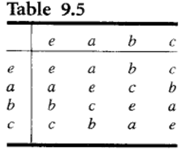
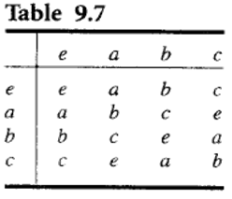
Groups of order 4
if x is any element in the group, then x² = e. The group is called the Klein group(克莱因群).
G = {a⁰, a¹, …, a^{n}}, Such group is called cyclic group.

Slide 17
Group of symmetries of the triangle
Let S₃ = {f₁, f₂, f₃, g₁, g₂, g₃} and introduce the operation *, followed by, on the set S₃

Slide 18
New Algebras from Old Ones
Subalgebra
Let G be a group. Then G and H = {e} are subgroups of G, called the trivial subgroups (平凡子群) of G.
Let G be a group, H be a nonempty subset of G. If ∀a,b∈H implies a⁻¹*b∈H, Then H is a subgroup of G.
Product Algebra
If (S,*) and (T,*') are groupoid, Then (S×T,*'') is a groupoid, where *'' is defined by (s1,t1)*'' (s2,t2)=(s1*s2, t1*'t2).
Quotient Algebra
Let R be a congruence relation on the groupoid (G, *).
⊗ be a relation from G/R × G/R to G/R in which the ordered pair ([a], [b]) is related to [a*b] for a,b∈G.

Slide 19
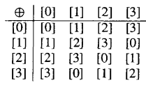
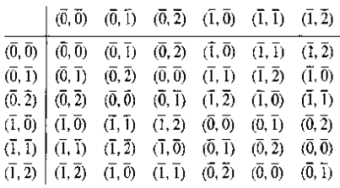
(Z_{n} , ⊕ ) 整数模n加群
( Z, + ) is a group,
Z /R is Z / ≡ (mod n) = {[0],[1],...[n-1]}, denoted by Z_{n} .
(Z_{n} ,⊕ ) is defined by [a]⊕[b]=[a+b].
⊕ is associative, [0] is an identity, [n-a] is the inverse of [a]. So (Z_{n} ,⊕ ) is an Abelian group.
Question: find a quotient group of Z₄?

Slide 20
Homomorphism – 同态
Let (S, *) and (T, *') be two groupoids. An everywhere-defined function f : S → T is called a homomorphism from (S, *) to (T, *’), if f(a*b) = f(a) *' f(b) for all a and b in S. denoted by S∼T.
f (S) is a homomorphic image(同态像) of S.
If f is onto, called onto homomorphism.
If f is bijection, called isomorphism.
If R is a congruence relation on a groupoid G, (G/R,⊗ ) be the corresponding quotient groupoid, then the function f_{R}: G→G/R defined by f_{R}(a) = [a], is an onto homomorphism, called the natual homomorphism.

Slide 21
Normal subgroup
Let H be a subgroup of a group G, a ∈ G
The left coset(左陪集) of H in G determined by a is the set aH = {ah| h ∈ H}. |aH| = |H|
The right coset (右陪集) of H in G determined by a is the set Ha = {ha | h ∈ H}. |Ha| = |H|
A subgroup H of G is normal(正规子群) if
aH = Ha, for all a in G
the quotient group G/R consists of all the left cosets of N = [e]. write G/R as G/N. [e] is a normal subgroup of G.

Slide 22
Fundamental Homomorphism
Let f be a homomorphism from a group (G, *) onto a group (G', *')
the kernel(核) of f, ker(f), be defined by ker(f) = {a ∈ G| f(a) = e'}.
Then
ker(f) is a normal subgroup of G.
The quotient group G/ker(f) is isomorphic to G’.
Question: homomorphism f from Z onto Z_{n} defined by f(m) = [r], where r is the remainder when m is divided by n. Find ker(f). [0]={m| m|n }

Slide 23
Group coding content
Encoding function（编码函数）
(m,n) encoding function e: B^{m} → B^{n}
Error detection（差错检测）
Hamming distance（海明距离）δ(x, y) = |x⊕y|
Properties of the distance function δ(x, y) ≤ δ(x, z) + δ(z, y)
e: B^{m} → B^{n} can detect k or fewer errors iff its minimum distance is at least k + l.
Group codes（群码）
e(B^{m}) = {e(b) | e(b) ∈ B^{n} } is a subgroup of B^{n}
Theorem: If e be a group code. The minimum distance of e is the minimum weight of a nonzero code word.
Parity check matrix
e_{H}(B^{m} ) = ker(f_{H}) ={ x | x * H = 0 iff x = e_{H}(b), b ∈ B^{m}}

Slide 24
Encoding function
Define an encoding function e_{H}: B^{m} → B^{n}

Slide 25
Decoding Function
An onto function d: B^{n} → B^{m} is called an (n, m) decoding function associated with e(与e关联的译码函数) if d(x_{t}) = b' ∈ B^{m} is such that when the transmission channel has no noise, then b' = b, that is, d o e = 1_{Bm}
(e, d) can correct k or fewer errors iff
the minimum distance of e is at least 2k + l.
maximum likelihood decoding function

Slide 26
Coset leader – 陪集头
Suppose that the code word x = e(b) is transmitted and that the word x_{t} is received.
The left coset of x_{t} is
x_{t} ⊕ N = {ε₁, ε₂,..., ε_{2m}} = ε_{i} ⊕ N, where ε_{i} = x_{t} ⊕ x^{(i)}
An element ε_{j} , having smallest weight, is called a coset leader.
x_{t}*H is called the syndrome(校验子) of x_{t .} x_{t}*H= ε_{j} *H.
If x_{t} = 001110, then f_{H}(x_{t}) = x_{t} * H = 101, same as ε=010000.
x = x_{t} ⊕ ε = 001110 ⊕ 01000 = 011110 = e(011), so decode 001110 as 011.

Slide 27
Chapter 8 Summary
Recurrence Relations
Solving Linear Recurrence Relations
A linear homogeneous recurrence relation of degree k with constant coefficients is a recurrence relation of the form a_{n} = c₁a_{n−1} + c₂a_{n−2} + ….. + c_{k} a_{n−k ,} where c₁, c₂, ….,c_{k} are real numbers, and c_{k} ≠ 0.
characteristic equation r^{k} – c₁r^{k−1} –⋯ – c_{k} = 0
has k distinct roots r₁, r₂, …, r_{k}.
where α₁, α₂,…, α_{k} are constants.
Generating Functions

Slide 28
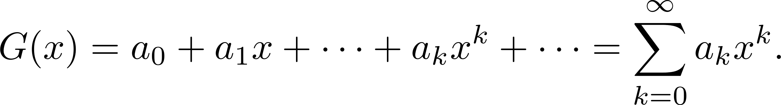
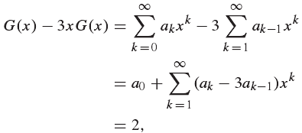
Generating Functions
Definition: The generating function for the sequence a₀, a₁,…, a_{k}, … of real numbers is the infinite series
Example 1: In how many different ways can 8 identical cookies be distributed among 3 distinct children if each child receives at 2~4 cookies?
(x² +x³ +x⁴)³ = x⁶+...+6x⁸ +...+x¹²

Slide 29
Graph Summary
Graph Terminology and Special Types of Graphs
Representing Graphs and Graph Isomorphism
Connectivity
Euler and Hamiltonian Graphs
Shortest-Path Problems
Planar Graphs
Graph Coloring

Slide 30

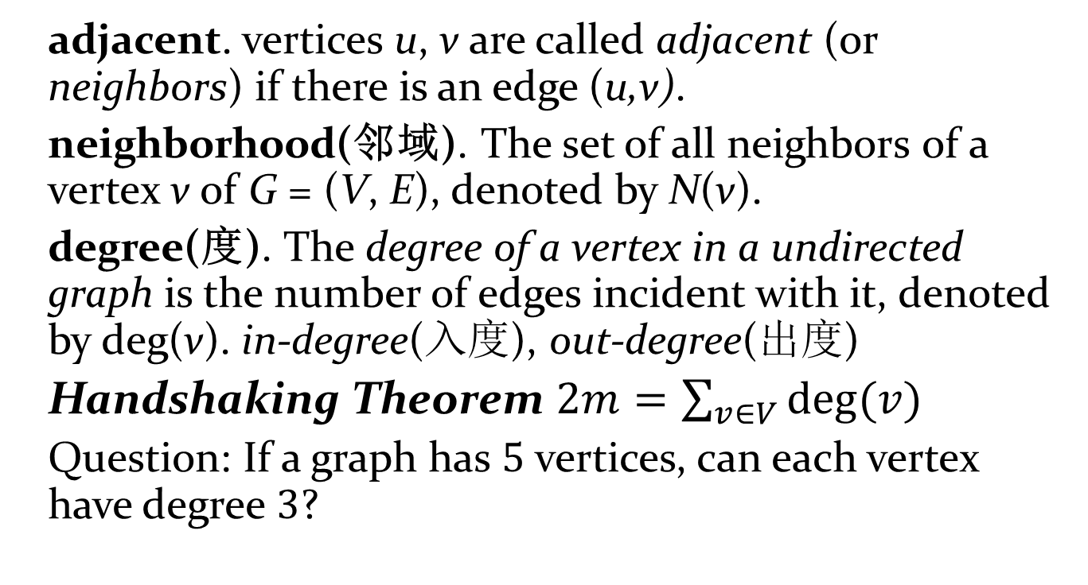
Basic graph Terminology
adjacent. vertices u, v are called adjacent (or neighbors) if there is an edge (u,v).
neighborhood(邻域). The set of all neighbors of a vertex v of G = (V, E), denoted by N(v).
degree(度). The degree of a vertex in a undirected graph is the number of edges incident with it, denoted by deg(v). in-degree(入度), out-degree(出度)
Handshaking Theorem $2m=\sum_{v∈V}{deg⁡(v)}$
Question: If a graph has 5 vertices, can each vertex have degree 3?

Slide 31

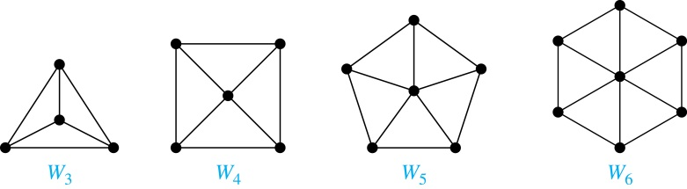
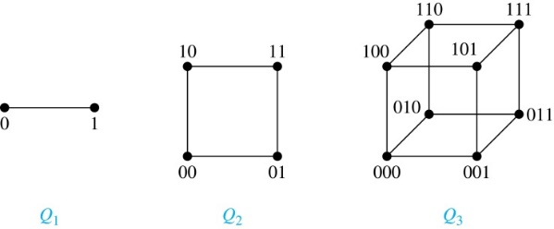
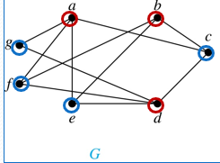
Special Graphs
complete graph K_{n}.
cycle graph C_{n} for n ≥ 3.
wheel graph W_{n} for n ≥ 3.
n-cube, Q_{n}
Bipartite Graphs(二分图)
maximum matching , complete matching from V₁ to V₂
complete bipartite graph K_{m,n}

Slide 32
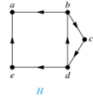
Representing Graphs and Graph Isomorphism Summary
Adjacency Lists(邻接表)
Adjacency Matrices(邻接矩阵)
Incidence Matrices(关联矩阵)
Isomorphism of Graphs
graph invariant(图形不变量).
the number of vertices, number of edges, and degree sequence (list of the degrees of the vertices in nonincreasing order).
Connectedness: connected, disconnected. connected component, strongly connected, weakly connected.
Vertex Connectivity κ(G)=min|V' |
Edge Connectivity λ(G)=min|E’ | κ(G) ≤ λ(G) ≤ δ(G)

Slide 33
Circuits Summary
Euler Paths and Circuits
Hamilton Paths and Circuits
procedure Euler(G: 所有顶点都为偶数度的连通多重图)
circuit := 在 G 中任选一个点为起点, 构造一条简单回路.
H := G 减去简单回路circuit用过的边和孤立点
while H 有边
subciruit := 选择H 和原回路的一个公共顶点, 以此为起点构造一条简单回路.
H := H 减去子回路 subciruit 用过的边和孤立点
circuit := circuit 合并 subcircuit .
return circuit{circuit 就是欧拉回路}

Slide 34
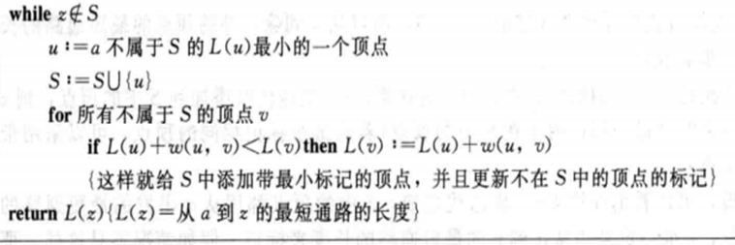
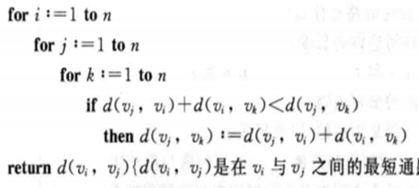
shortest path Problem
Determining the shortest path from a vertex to an assigned vertex. Dijkstra Algorithm
Determining the shortest path of any two vertices in the graph.
Distance Matrix: Adjacent Matrix with Weights
d_{ij}²=min{d_{i1}+d_{1j}, d_{i2}+d_{2j},…, d_{in}+d_{nj}}
Floyd algorithm

Slide 35
Planar Graphs 平面图
A graph is called planar if it can be drawn in the plane in such a way that no two edges cross.
A drawing of a planar graph divides the plane into faces , regions bounded by edges of the graph. (outside face)
A planar graph G, total degrees of faces are double of edges. Σdeg(R_{i})=2e.
Euler Theorem: Let G be a connected planar graph. Then r = e − v +2.
Kuratowski’s Theorem: A graph is planar if and only if it contains no subgraph obtainable from K₅ or K_{3,3} by replacing edges with paths.

Slide 36
Graph Coloring
dual graph(对偶图): given a map M, construct a graph G_{M} by
Vertex u ↔ region R_{u}
Edge (u, v) ↔ regions R_{u} and R_{v} share a common boundary.
The smallest number of colors needed to produce a proper coloring of a graph G is called the chromatic number of G(G最小着色数), denoted by χ(G).
If G is a graph and n ≥ 0 is an integer, let P_{G}(n) be the number of ways to color G properly using n or fewer colors. called the chromatic polynomial(着色多项式) of G.

Slide 37
Theorem 2
Let G = (V, E, γ) be a graph with no multiple edges, and let e ∈ E, say e = {a, b}.
G_{e} : subgraph of G obtained by deleting e,
G^{e} : the quotient graph of G obtained by merging the end points of e.
Then with x colors:
Example:
P_{G} (x) = x²(x-1)(x-2) - x(x-1)(x-2)= x (x-1)²(x-2)

Slide 38
Maximum Flow Algorithm
labeling algorithm(标记算法)
residual capacity(剩余容量)
Let N be a network and let G be the symmetric closure of N.
If (i,j)∈N and e_{ij}=C_{ij}-F_{ij}>0.
If (i,j) ∉ N, e_{ij}=F_{ji} if F_{ji} >0. 虚边标记作修正
The initial flow F_{ij} is 0.
N₁ N₂(j), smallest node and unlabeled nodes.
Path π={…}, E_{n}=min(residual capacity), e_{ij} - E_{n} , and the symmetric edges e_{ji} + E_{n} .

Slide 39
Capacity of a cut K
The capacity of a cut K, c(K), is the sum of the capacities of all edges in K.
If F is any flow and K is any cut, then
value(F) ≤ c(K).
A maximum flow F in a network has value equal to the capacity of a minimum cut of the network.

Slide 40
Trees Summary
Spanning Trees
Depth-First Search
Breadth-First Search
Minimum Spanning Trees
Prim’s Algorithm (权值最小边+邻接且有新点的剩余最小边)
Kruskal’s Algorithm(权值最小的边 且 两端点∉T中同一连通集合)
Rooted Trees
Parent, child, siblings, ancestors祖先, descendants子孙, leaf, internal vertices
full m-ary tree : n = mi + 1
If an m-ary tree of height h has l leaves, then h ≥ ⌈log_{m} l⌉.
Properties of Trees
there is a unique simple path between any two of its vertices.
Tree Traversal: preorder, inorder, postorder traversal.

